Slide 1
BDA 102 - Big Data Analytics
Week 10

Slide 2
Learning Objective
Recommendation systems

Slide 3
Introduction
Recommendation engines help to identify products that a user may like based on what others watched in the past
Recommendation algorithm types
Content Based Filtering
Collaborative filtering
Knowledge based
Hybrid
Use cases:
People who bought this also bought …
Engagement (e.g. youtube recommendation)
Exploring new items
Change behavior
80 percent of movies watched on Netflix came from recommendations
60 percent of video clicks came from home page recommendation in YouTube

Slide 4
Key performance measures (KPIs)
Relevance
Novelty
Serendipity (unexpected & surprising)
Diversity & coverage (not all similar candidates)
Accuracy
Adaptation and context awareness
Trust, explanation
Scalability, responsibility, availability

Slide 5
Recommendation system Examples
Amazon.com: Books and other products
Netflix: DVDs, Streaming Video
Jester: Jokes
GroupLens: News
MovieLens: Movies
last.fm: Music
Google News: News
Google Search: Advertisements
Facebook: Friends, Advertisements
Pandora: Music
YouTube: Online videos
Tripadvisor: Travel products
IMDb: Movies

Slide 6
Process
A query can include various user and contextual features, is generated when a user visits the system.
The recommender system returns a list of products on which users can perform certain actions such as clicks or purchases.
A short list of items that best match the query using various signals, usually a combination of machine-learned models and human-defined rules.
After reducing the candidate pool, the ranking system ranks all items by their scores.
These user actions, along with the queries, are recorded in the logs as the training data for the learner.

Slide 7
Example 1
How would you recommend a vacation house to a user?
Features
Properties of the user
Properties of the house
Previous rentals of a user
Previous renters of a house
Compare similar users
Compare similar items
Targets
Rating for unseen properties
Next rental property

Slide 8
Data
The attribute information about the users and items such as textual profiles or relevant keywords.
➔ content-based
User requirements
knowledge-based
The user-item interactions, such as ratings or buying behavior
➔ collaborative filtering
Social/ community information
➔ Community based
Hybrid systems can combine the strengths of various types of recommender systems to create techniques that can perform more robustly in a wide variety of settings.

Slide 9
Types of Ratings (feedbacks)
Explicit
High quality when given
Both positive and negative
End-of-scale bias
Not always available
The ratings are often specified on a scale that indicates the specific level of like or dislike of the item at hand.
Usually, the ratings are interval-based, where a discrete set of ordered numbers are used to quantify like or dislike.
forced choice rating system
Ordinal and binary rating

Slide 10
Types of Ratings (feedbacks)
Implicit feedback
Customer preferences are derived from their activities rather than their explicitly specified ratings.
Abundant, theoretically based on observations
No negative feedback
Inherently noisy
Need to model both preference and confidence

Slide 11
Content based filtering
It uses item features to recommend new items that are similar to what the user has liked in the past
uses attributes of the items to recommend new items to a user
Doesn't take into account the behavior or ratings of other users.
Casino-Royal
2/10
6/10
8/10
Comedy
Action
Romance

Slide 12
Content based filtering
Pros
Doesn't need information about other users.
Can recommend niche items.
Cons
Requires domain knowledge to hand-engineer features.
Difficult to expand interests of user.
What if we don't know the best factors to compare with?

Slide 13
User based
User based also needs the complete preference of the users
Alice Casino-Royal is Action
9/10
Alice
2/10
6/10
8/10
Comedy
Action
Romance

Slide 14
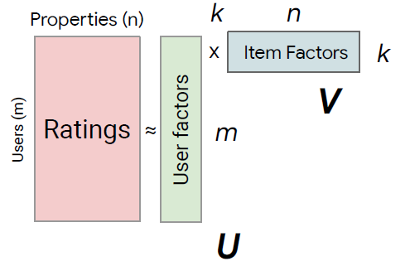
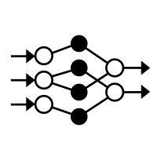
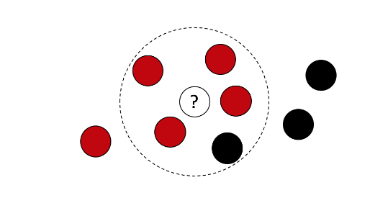
Collaborative Filtering
There are two types of methods that are commonly used in collaborative filtering,
Memory based
Model based
Nearest Neighbor
Matrix Factorization
Deep Learning

Slide 15
Collaborative filtering
Learns latent factors and can explore outside user's personal bubble
Use similarities between items and user simultaneously in an embedding space
Embedding space
Each user and item is a d-dimensional point within an embedding space.
Embeddings can be learned from data.
We're compressing the data to find the best generalities to rely on, called latent factors.

Slide 16
Memory-based methods
Also referred to as neighborhood based. The ratings of user-item combinations are predicted on the basis of their neighborhoods. These neighborhoods can be defined in one of two ways:
User-based collaborative filtering:
Similarity functions are computed between the rows of the ratings matrix to discover similar users.
Item-based collaborative filtering:
Similarity functions are computed between the columns of the ratings matrix to discover similar items.
Simple to implement and easy to explain.
Do not work very well with sparse ratings matrices.

Slide 17
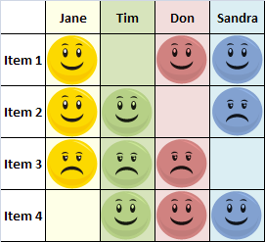
Nearest Neighbors
“People who liked this also liked…”
abcd
User-to-User
Recommendations are made by finding users with similar tastes. Jane and Tim both liked Item 2 and disliked Item 3; it seems they might have similar taste, which suggests that in general Jane agrees with Tim. This makes Item 1 a good recommendation for Tim. This approach does not scale well for millions of users.
Item to Item
Item-to-Item
User to User
Recommendations are made by finding items that have similar appeal to many users. Tom and Sandra are two users who liked both Item 1 and Item 4. That suggests that, in general, people who liked Item 4 will also like item 1, so Item 1 will be recommended to Tim. This approach is scalable to millions of users and millions of items.

Slide 18
Memorization vs generalization
Memorization
learning the frequent co-occurrence of items or features and exploiting the correlation available in the historical data.
more topical and directly relevant to the items on which users have already performed actions.
Generalization
based on transitivity of correlation and explores new feature combinations that have never or rarely occurred in the past.
generalization tends to improve the diversity of the recommended items.
One challenge in recommender systems is to achieve both memorization and generalization.

Slide 19
Model-based methods
In model-based methods, machine learning and data mining methods are used in the context of predictive models. In cases where the model is parameterized, the parameters of this model are learned within the context of an optimization framework.
Some examples of such model-based methods include decision trees, rule-based models, Bayesian methods and latent factor models.
Many of these methods, such as latent factor models, have a high level of coverage even for sparse ratings matrices.

Slide 20
Nearest neighbor
Summary of the nearest neighbor collaborative filtering.
Set up data
Construct rating matric
Find the k-nearest neighbor
Find n top recommendation

Slide 21
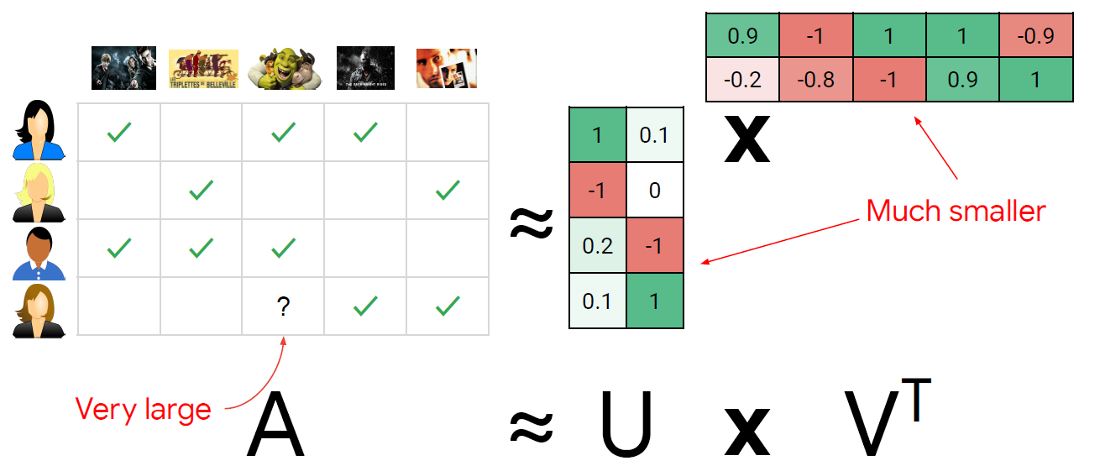
Collaborative filtering - factorization
The factorization splits this matrix into row factors and column factors that are essentially user and item embeddings

Slide 22
Summary
Content based filtering
Collaborative filtering
Hybrid filtering
Model based
Memory based
Clustering
Association
Bayesian
Deep learning
Items-based
user-based
Social network-based (trust)
Knowledge based

Slide 23
Why Deep Neural Networks for Recommendation
Deep neural networks are composite in the sense that multiple neural building blocks can be composed into a single (gigantic) differentiable function and trained end-to-end.
Nonlinear Transformation.
Reduce the effort in hand-craft feature design.
Enables recommendation models to include heterogeneous content information such as text, images, audio and even video
Sequence Modelling
Flexibility

Slide 24
Case study - Movie recommendation
Feature set 1
Genres
Themes
Actors/directors involved
Professional ratings
Movie summary text
Stills from movie
Movie trailer
Professional reviews
Feature set 2
User ratings
User views
User wish list/cart history
User purchase/return history
User reviews
User-answered questions
User-submitted photos
User-submitted videos
Feature set 3
Demographic information Knowledge-based
Location/country/language
Genre preferences
Global filters
User “about me” snippets

Slide 25
On Potential Limitations
Interpretability
Data Requirement
Extensive Hyper-parameter Tuning

Slide 26
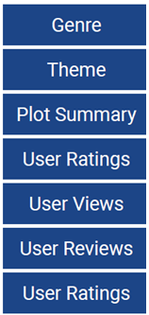
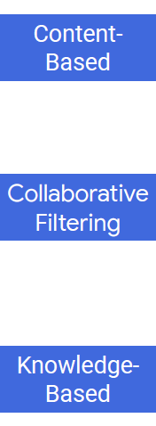
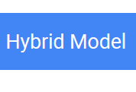
Hybrid model

Slide 27
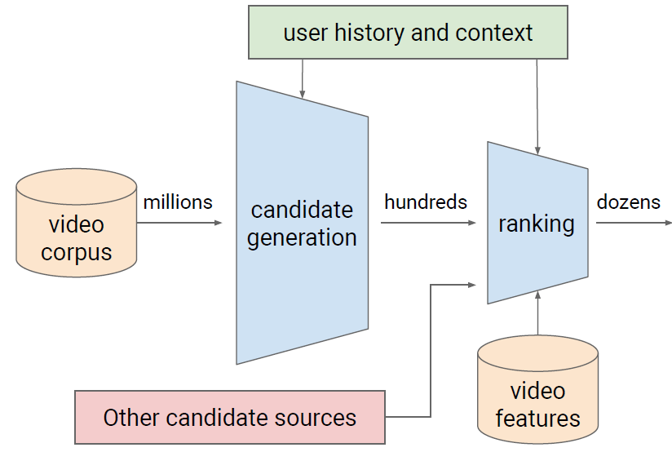
You tube recommendation system
https://storage.googleapis.com/pub-tools-public-publication-data/pdf/45530.pdf

Slide 28
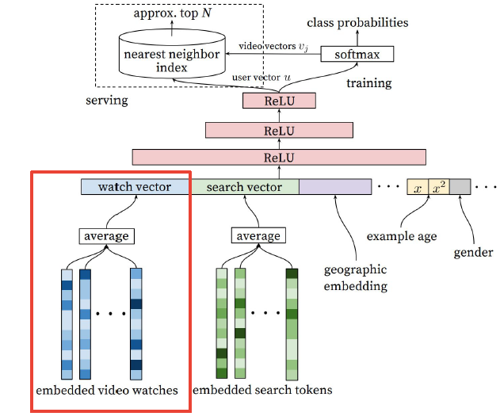
Candidate generation
https://storage.googleapis.com/pub-tools-public-publication-data/pdf/45530.pdf

Slide 29
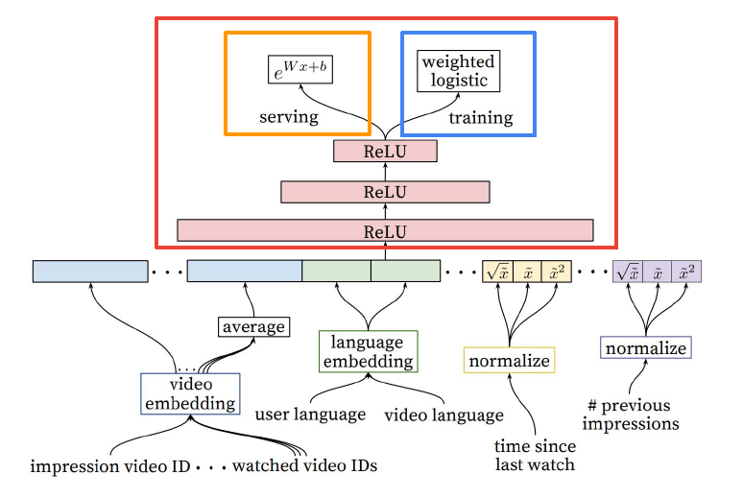
Ranking
https://storage.googleapis.com/pub-tools-public-publication-data/pdf/45530.pdf

Slide 30
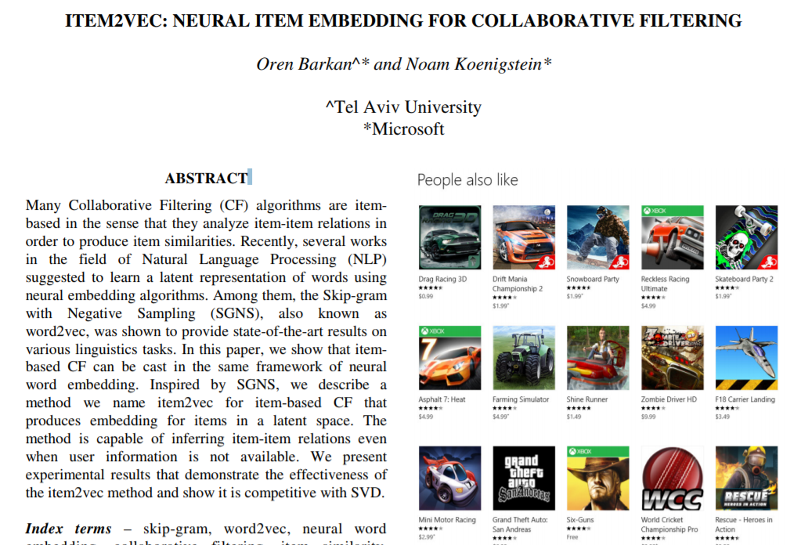
Item2Vec
Item2vec is a deep learning technique based on word2vec.
It utilizes store purchase orders as contextual information, which implies that items bought under analogous circumstances are comparable
https://arxiv.org/ftp/arxiv/papers/1603/1603.04259.pdf

Slide 31
Item2Vec: Item Embedding
Represent each item with a low-dimensional vector
Item similarity = vector similarity
Learned from users’ sessions.
Inspired by Word2Vec
Words = Items
Sentences = Users’ Sessions

Slide 32
Autoencoder based Recommendation
Relationship with Missing Value Analysis
Collaborative filtering can be viewed as a (difficult) special case where the underlying data matrix is very large and sparse.
Two general ways of applying autoencoder to recommender system:
using autoencoder to learn lower-dimensional feature representations
Filling the blanks of the interaction matrix directly in the reconstruction layer.
Almost all the autoencoder variants such as denoising autoencoder, variational autoencoder, contactive autoencoder and marginalized autoencoder can be applied to recommendation task.

Slide 33
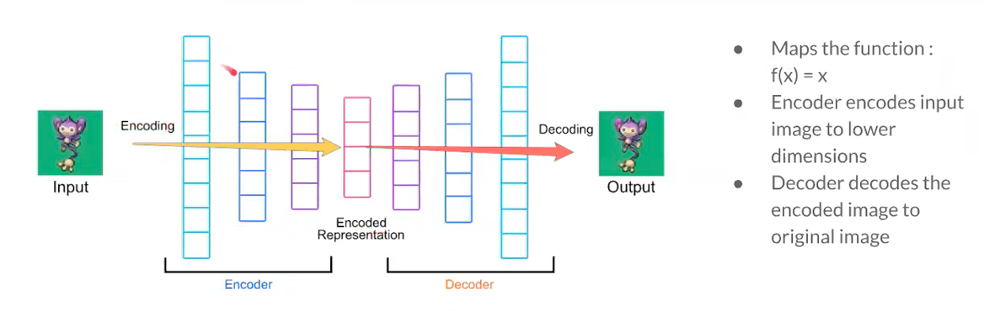
Autoencoder based Recommendation

Slide 34
Convolutional Neural Networks based Recommendation
Most of the CNNs based recommendation models utilize CNNs for feature extraction.
CNNs can be used for feature representation learning from multiple sources such as image, text, audio, video, etc.
The application could be Point-of-Interest (POI) recommendation, and proposed a visual content enhanced POI recommender system (VPOI)

Slide 35
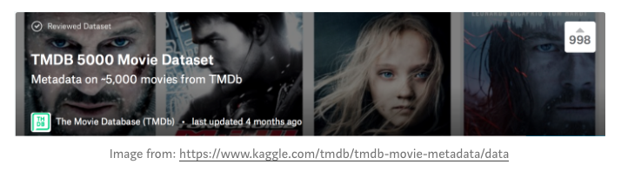
Convolutional Neural Networks based Recommendation
build a movie recommender that only takes the movie thumbnail/poster as an input.
The main idea is to create a movie poster image dataset and extract features from a pre-trained (ConvNet) trained on imagenet.
Interest is in finding similar movie posters based on the visual aspects of the poster image
At last use the Nearest Neighbors algorithm to cluster the similar posters. https://towardsdatascience.com/creating-a-movie-recommender-using-convolutional-neural-networks-be93e66464a7

Slide 36
Recurrent Neural Networks based Recommendation
RNNs are suitable for sequential data processing.
They are a natural choice for dealing with the temporal dynamics of interactions and sequential patterns of user behaviours, as well as side information with sequential signals, such as texts, audio, etc.
Session-based Recommendation without User identifier.
no access to user’s identifier and her long period consumption habits or long-term interests.

Slide 37
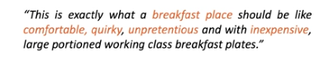
Recurrent Neural Networks based Recommendation
We present a recurrent neural network to generate recommender on users opinion.
Pre-process the data and trained them using GloVe.

Slide 38
Deep Reinforcement Learning for Recommendation
Most recommendation models consider the recommendation process as a static process, which makes it difficult to capture user’s temporal intentions and to respond in a timely manner.
Deep Reinforcement Learning can tackle the following three challenges:
dynamic changes of news content and user preference;
incorporating return pattern (to the service) of users;
increase diversity of recommendations

Slide 39
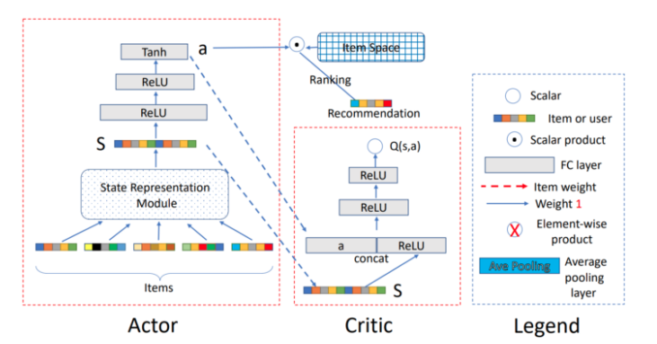
Deep Reinforcement Learning for Recommendation
It is also helpful to predict future behavior. For example, the recommender suggests the user buy a book. It buys it no problem and receives an immediate reward of 100. But it may also happen that the user will want to return that book in the future, penalizing us by -500. All future actions need to be taken into consideration.
https://towardsdatascience.com/deep-reinforcement-learning-for-news-recommendation-part-1-architecture-5741b1a6ed56

Slide 40
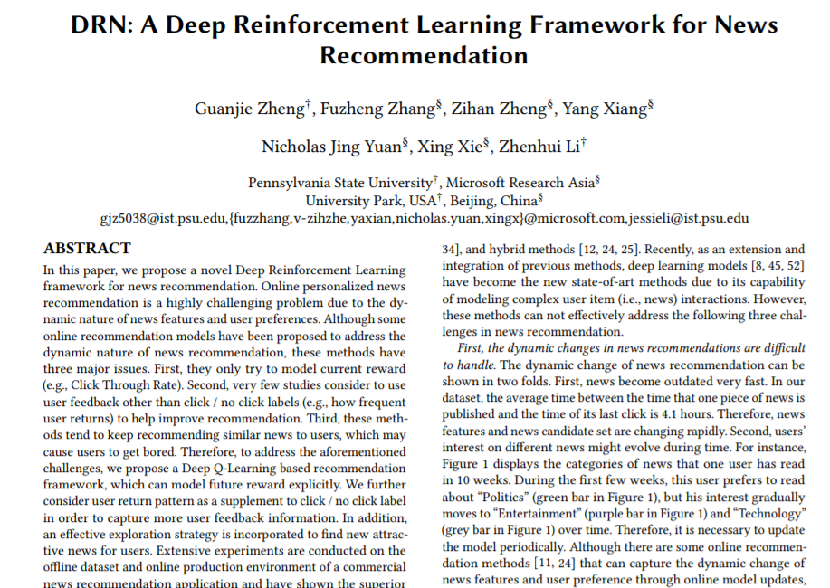
Example
http://www.personal.psu.edu/~gjz5038/paper/www2018_reinforceRec/www2018_reinforceRec.pdf

Slide 41
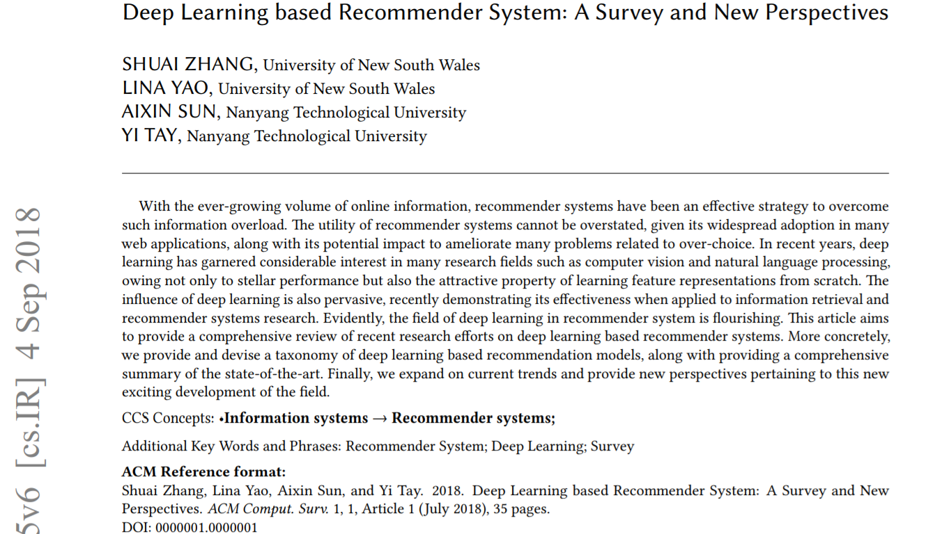
Deep Learning based Recommender System

Slide 42
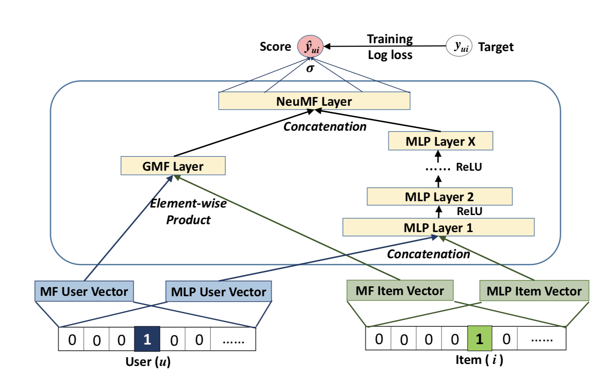
Recommendation-Neural Network algorithm

Slide 43
Keras models
Sequential API:
allows to create models layer-by-layer for most problems.
not allow to create models that share layers or have multiple inputs or outputs.
Functional API:
allows to create models that have a lot more flexibility as you can easily define models where layers connect to more than just the previous and next layers.
you can connect layers to (literally) any other layer. As a result, creating complex networks such as residual networks become possible.

Slide 44
Sequential API
The layers can be defined and passed to the Sequential as an array:
Layers can also be added piecewise:
1 2 3 | from keras.models import Sequential from keras.layers import Dense model = Sequential([Dense(2, input_dim=1), Dense(1)])
1 2 3 4 5 | from keras.models import Sequential from keras.layers import Dense model = Sequential() model.add(Dense(2, input_dim=1)) model.add(Dense(1))

Slide 45
Functional
Defining Input
Define a standalone Input layer that specifies the shape of input data.
The input layer takes a shape argument that is a tuple that indicates the dimensionality of the input data.
When input data is one-dimensional, such as for a multilayer Perceptron, the shape must explicitly leave room for the shape of the mini-batch size used when splitting the data when training the network.
from keras.layers import Input
visible = Input(shape=(2,))

Slide 46
Functional
Connecting Layers
The layers in the model are connected pairwise.
This is done by specifying where the input comes from when defining each new layer. A bracket notation is used, such that after the layer is created, the layer from which the input to the current layer comes from is specified.
from keras.layers import Input
from keras.layers import Dense
inp = Input(shape=(2,))
out = Dense(2)(inp)

Slide 47
Functional
Creating the Model
After creating all of your model layers and connecting them together, you must define the model.
As with the Sequential API, the model is the thing you can summarize, fit, evaluate, and use to make predictions.
Keras provides a Model class that you can use to create a model from your created layers. It requires that you only specify the input and output layers. For example:
from keras.models import Model
from keras.layers import Input
from keras.layers import Dense
visible = Input(shape=(2,))
hidden = Dense(2)(visible)
model = Model(inputs=visible, outputs=hidden)

Slide 48
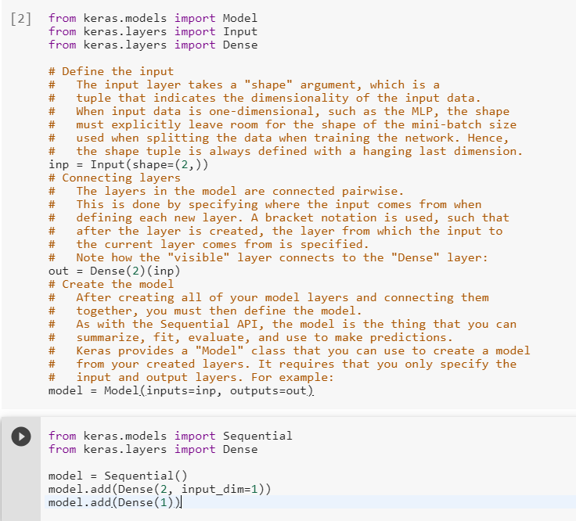
Sequential vs functional

Slide 49
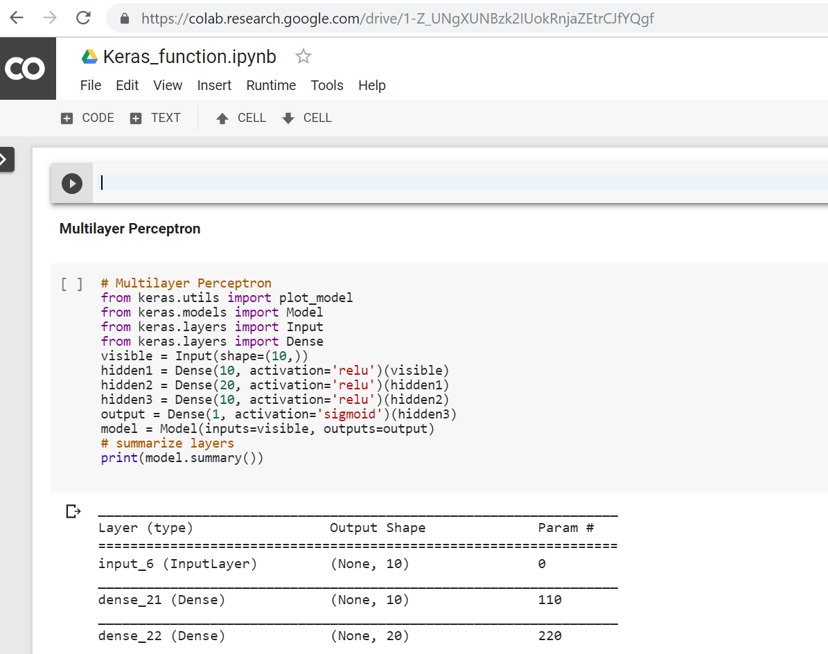
Demo: Keras_function.ipynb

Slide 50
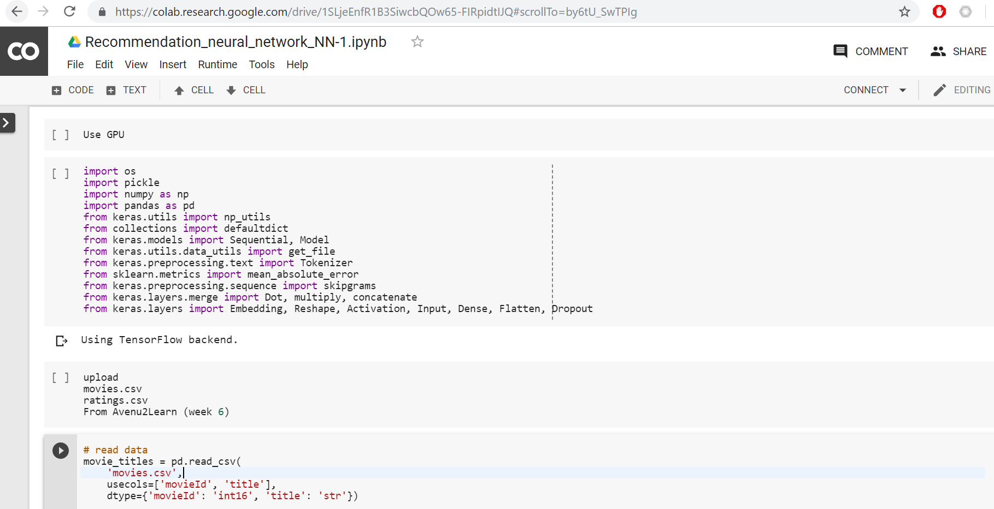
Lab: Recommendation_neural_network_NN-1.ipynb

Slide 51
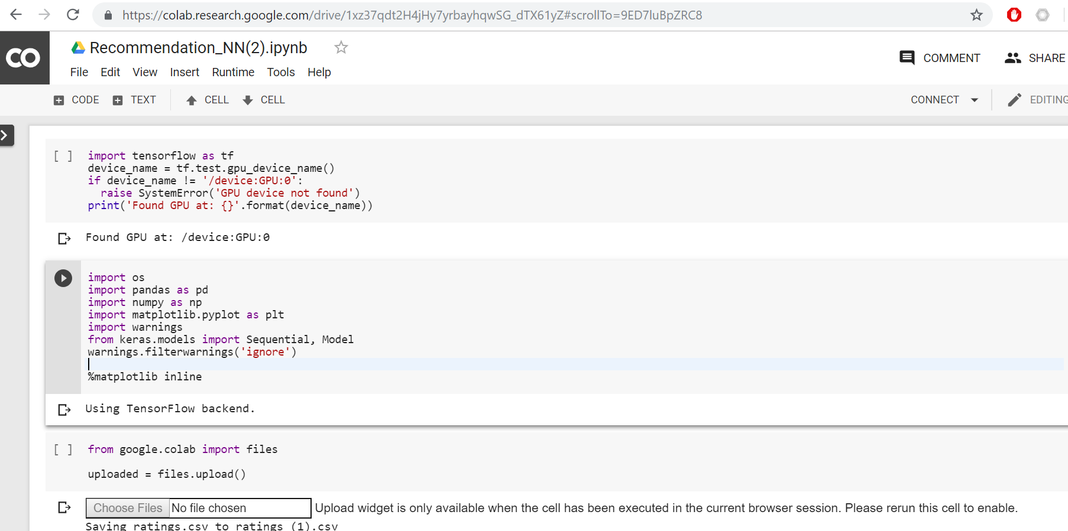
Lab: Recommendation_NN(2).ipynb

Slide 52
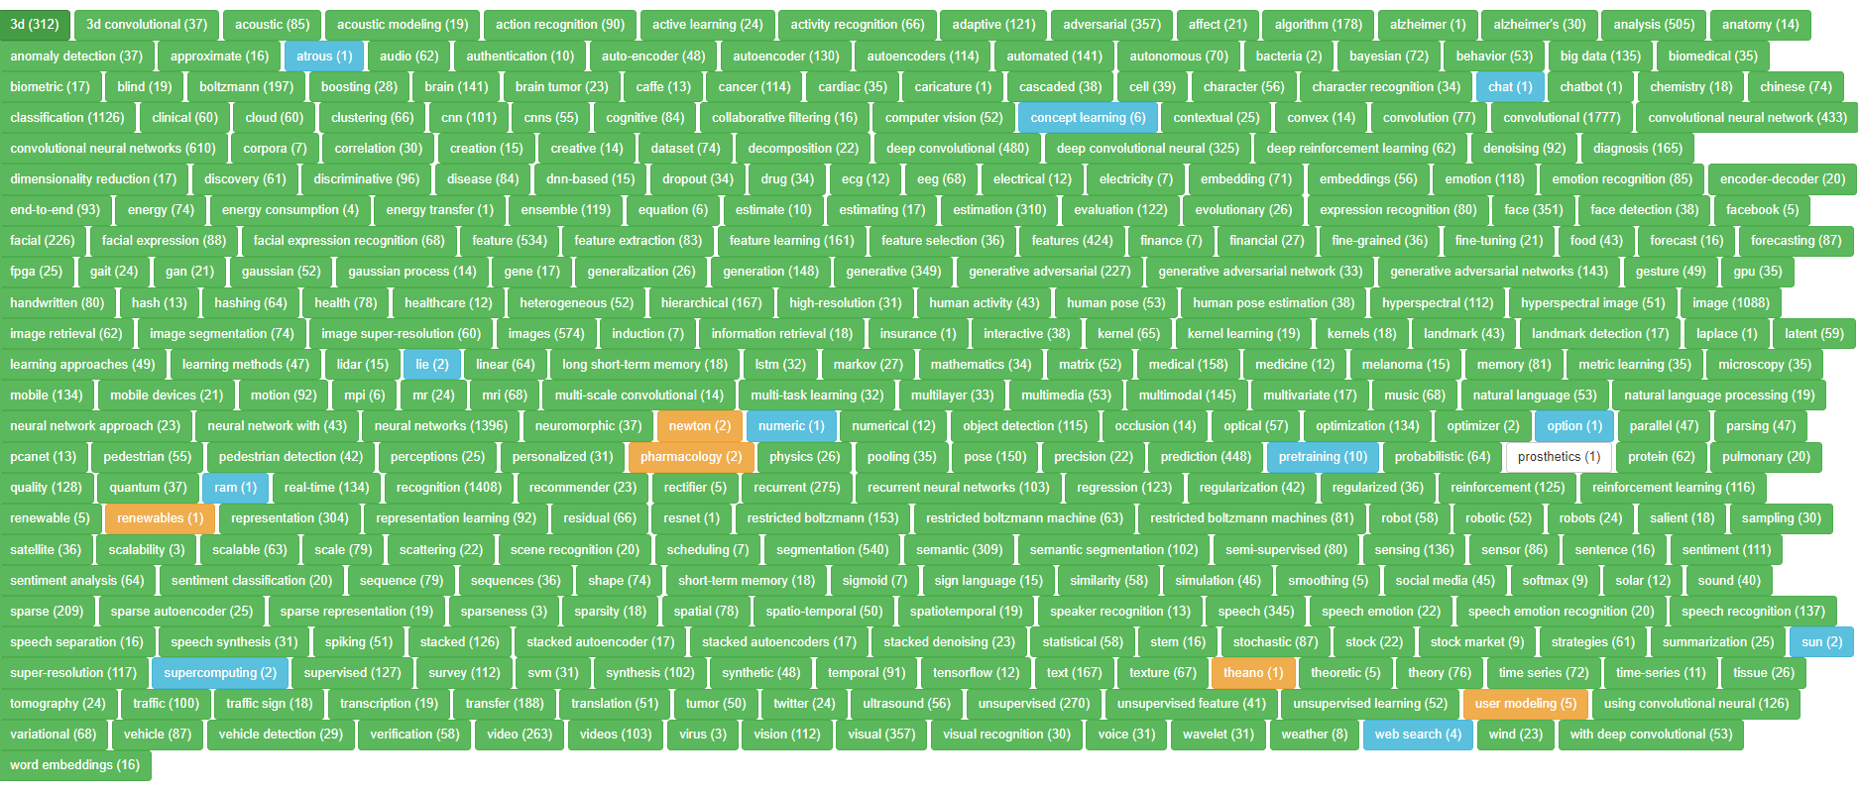
More resources
https://ai.amundtveit.com/

